Slide 1
Git & GitFlow: Version Control and Branching Strategies
An Overview of Git Basics and GitFlow Methodology
Presented by: AngsarAidarbek
Date: 17/09/2024

Slide 2

Introduction to Git
Distributed version control system (DVCS)
Tracks changes, manages project history, and supports collaboration
Multiple developers can work on the same codebase
Key Features:
- Distributed: Each developer has a full copy of the repository and its history
- Version tracking: Every change is tracked with a unique ID (commit)
- Branching: Easy to create, switch, and merge branches
Benefits:
- Speed and flexibility for projects of any size
- Works offline
Why Git?
- Industry standard
- Popular platforms: GitHub, GitLab, Bitbucket

Slide 3
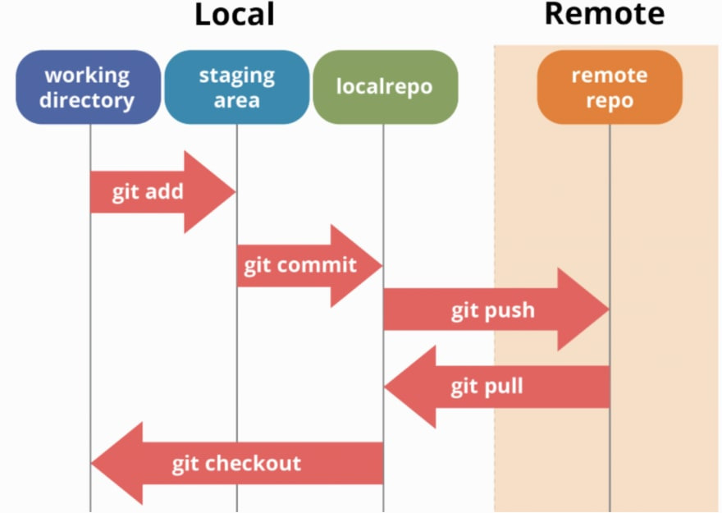
Git Basic Concepts
Repositories:
- Local repository: Resides on your computer
- Remote repository: Hosted on a server (e.g., GitHub)
Key Commands:
- git init: Creates a new Git repository
- git clone: Copies an existing remote repository
- git add: Stages changes for commit
- git commit: Saves changes with a message
- git push: Sends commits to the remote repository
- git pull: Fetches and merges changes from the remote repository
Example:
- Test new features,
- Fix Bugs
- Provide multiple views
This Photo by Unknown Author is licensed under CC BY-NC-ND

Slide 4
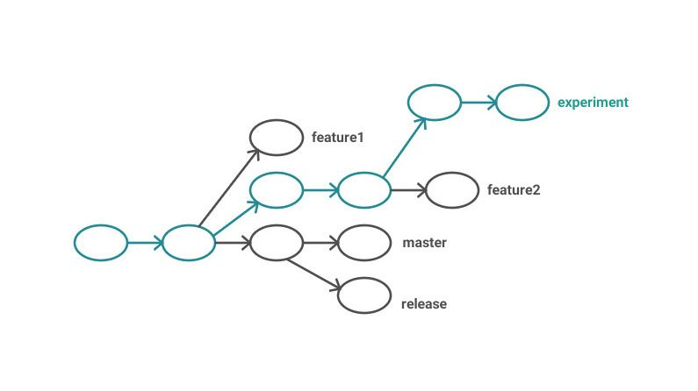
Branching in Git
Isolated environments for development
Multiple branches for working on different features or fixes
Easy branch switching: git checkout <branch>
Common Branches:
- main or master: Production-ready code
- Feature branches: Isolated development (e.g., feature/new-api)
- Hotfix branches: Urgent patches (e.g., hotfix/security-fix)
Example: Create and merge feature branch

Slide 5

Introduction to GitFlow
GitFlow: Structured branching model by Vincent Driessen
Formal workflow for managing features, releases, and fixes
Ensures production code remains stable
Best suited for larger projects with many developers
Visual diagram: interaction between branches
This Photo by Unknown Author is licensed under CC BY-SA

Slide 6
GitFlow Workflow
- main:
Stable, production-ready code
1
- develop:
Central branch for ongoing development
2
- Feature branches: Develop isolated new features
3
- Release branches: Prepare code for production
4
- Hotfix branches: Fix critical production issues
5

Slide 7
Key Benefits of GitFlow
Organized Process:
Clear guidelines for feature development, releases, and bug fixes.
Defined stages for development, testing, and production
Improved Collaboration:
Developers can work on multiple features or fixes simultaneously
Minimize Errors:
Stable production code is always maintained
Final testing is done on release branches

Slide 8
Conclusion and Best Practices
Best suited for large, long-running projects
Can be overkill for smaller projects or fast-paced teams
Best Practices:
Stay synchronized (git pull/status/diff requests)
Maintain clean divergence of branches (git branch/branch –d requests)
Write clear commit messages (key points about the changes)
Questions?

